Slide 1
Biology and Psychology of Mental Health
Joy Bose

Slide 2
Topics
Mental health and mental wellbeing
Factors for Schizophrenia / Psychosis
Factors for Addiction
Stress and Mindfulness
Depression and Cognitive Behavioral Therapy (CBT) for Depression
Psychology applied to improve learning

Slide 3
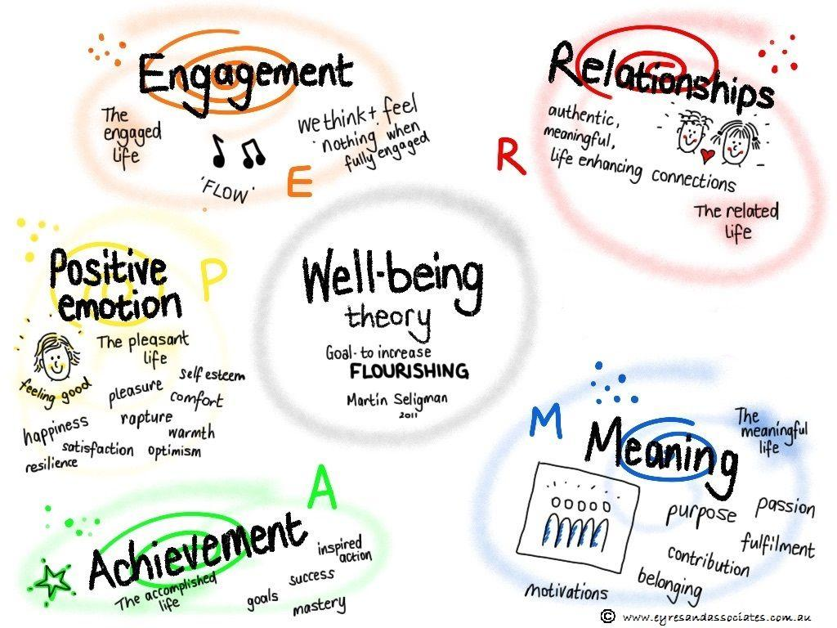
What is mental health
Bio – psycho – social basis = biological + psychological + social
Absence of mental disorders
Mental disorder: disorder or disability of the mind (1983 mental health act, UK)
Examples of mental disorders
affective disorders, such as depression and bipolar disorder;
schizophrenia and delusional disorders; neurotic disorders; organic mental disorders, such as dementia and delirium;
personality and behavioural changes caused by brain injury; importantly from a legal perspective, personality disorders;
mental and behavioural disorders caused by psychoactive substance use;
eating disorders;
learning disabilities; autistic spectrum disorders; and behavioural and emotional disorders of children and young people.
Positive psychology for mental health: Paying more attention to building on positive behaviors and traits already present in individuals. Positive psychology interventions aim to boost positive emotions and help clients find meaning in life.

Slide 4
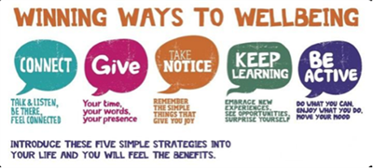
5 steps to mental wellbeing
From UK NHS toolkit-- ‘Five steps to mental wellbeing.’
‘connect’-- connect with the people around you;
‘give to others’-- such as volunteering at your local centre, can improve your mental wellbeing and help you build new social networks;
‘be mindful / take notice’-- be more aware of the present moment, including your thoughts and feelings, your body, and the world around you.
‘keep learning’-- learning new skills can give you a sense of achievement and new confidence, so why not sign up for that cooking course, start learning to play a musical instrument
‘be active’-- you don’t have to go to the gym, which I’m pleased about-- take a walk, go cycling, or play a game of football

Slide 5
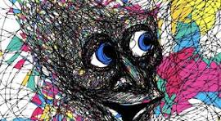
Example of schizophrenia
Schizophrenia is a mental disorder characterized by two or more of the following symptoms during a one-month period as per DSM-5 (American Psychiatric Association, 2013):
two or more symptoms among hallucinations, delusions, disorganized speech, disorganized or catatonic behavior,
negative symptoms, and which are not attributable to any other condition.
A form of psychosis
Hears voices: cannot filter our irrelevant stimuli
Feels others can read their mind
Subject gets paranoid: cuts off social interaction
Often occurs in more creative people (see film, a beautiful mind)
Some people can have multiple episodes at various intervals

Slide 6
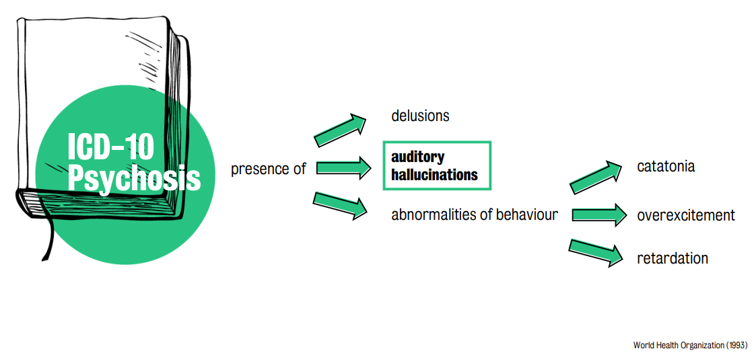

Slide 7
Example of schizophrenia
Associated with increased dopamine (neurotransmitter) synthesis
Dopamine hypothesis of schizophrenia: dopamine neurotransmitters disturbances in the mesolimbic pathway and prefrontal cortex of the brain could be a cause of the positive symptoms of schizophrenia
Associated with environmental factors and triggers such as stress
Decrease of grey matter in the brain: loss of brain tissue, cognitive difficulties
Genetic factors: Ripke et al. (2014) identified 108 independently associated genetic loci that function as markers of schizophrenia
Treated by antipsychotic drugs: Block dopamine receptors

Slide 8
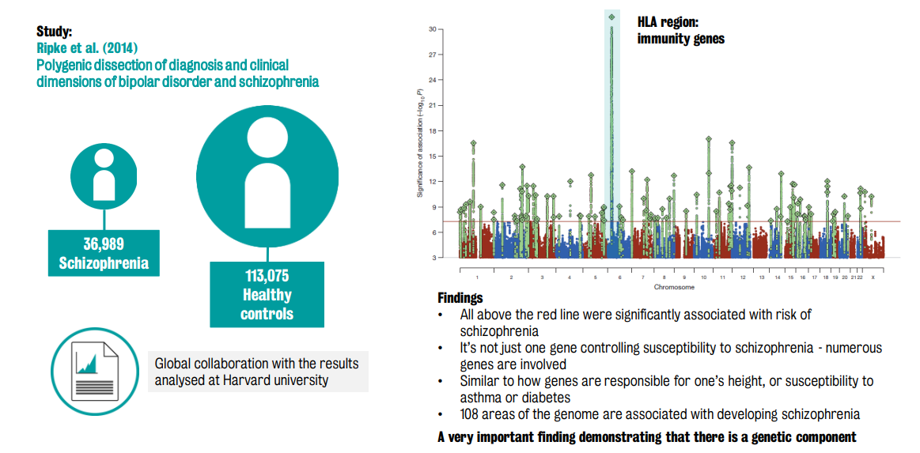
Genetic factors

Slide 9
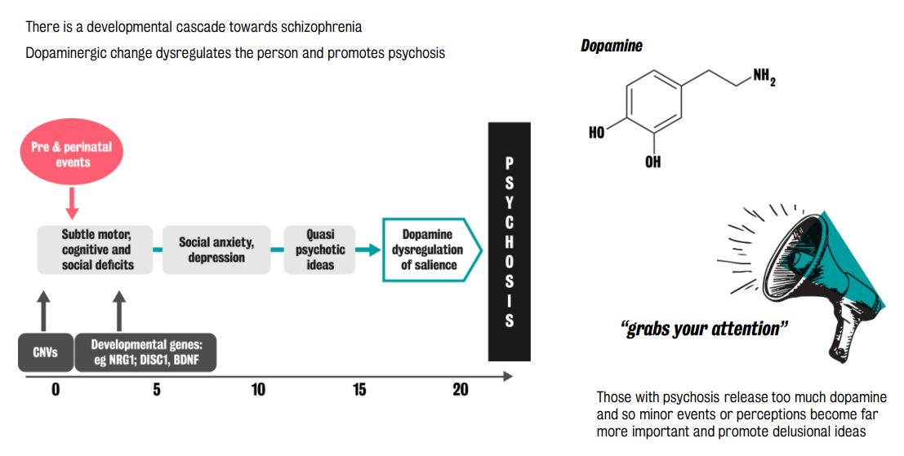
Developmental factors

Slide 10
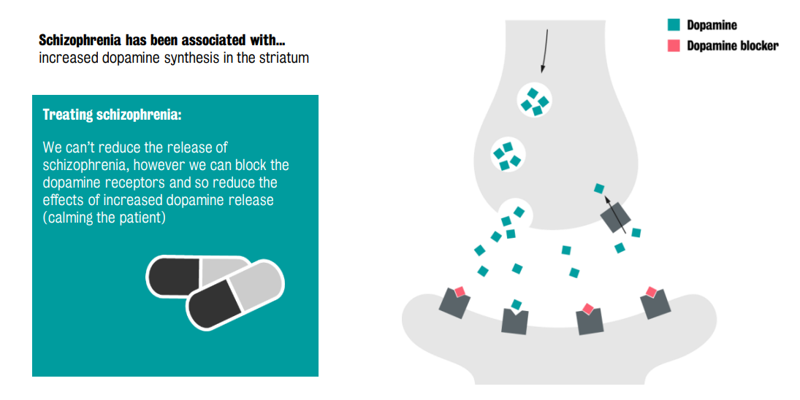
Biological factors

Slide 11
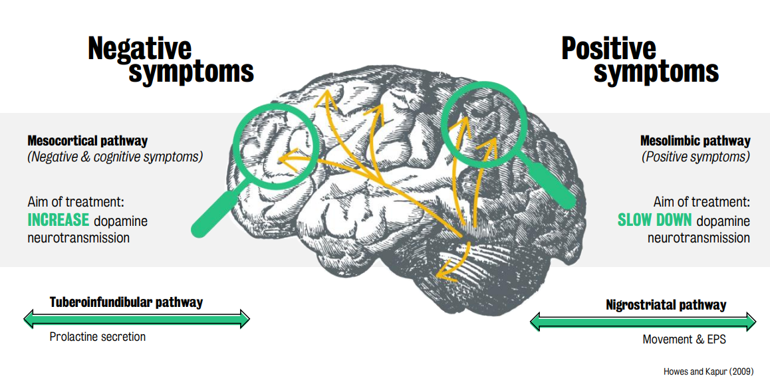
Biological factors

Slide 12
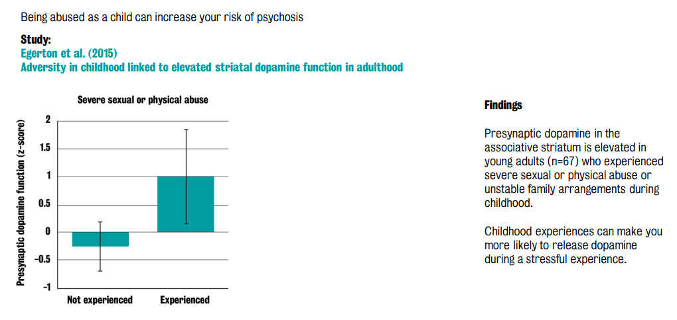
Social factors for psychosis/ schizophrenia

Slide 13
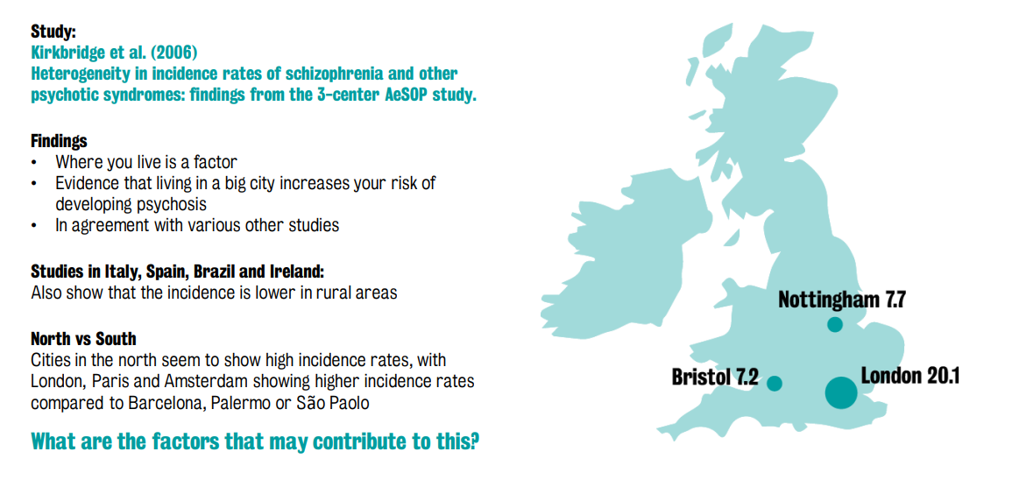
Social fragmentation: psychosis/ schizophrenia

Slide 14
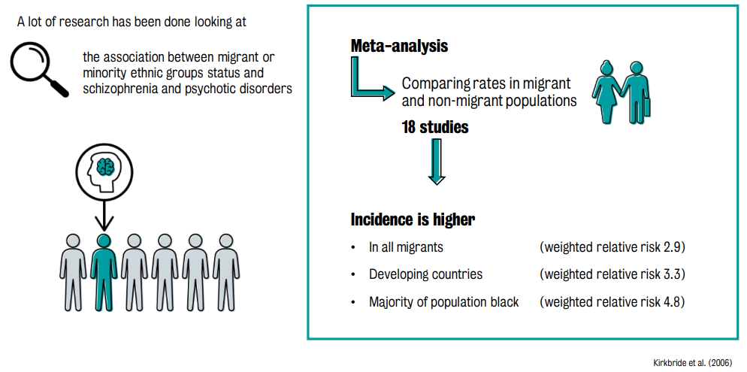
Social factors for psychosis/ schizophrenia

Slide 15
Example of addiction
Example: addiction to drugs, alcohol
Genetic factors: Twin studies
Social and developmental factors
Biology of addiction: Reward pathway of the brain hijacked by addictive drugs

Slide 16
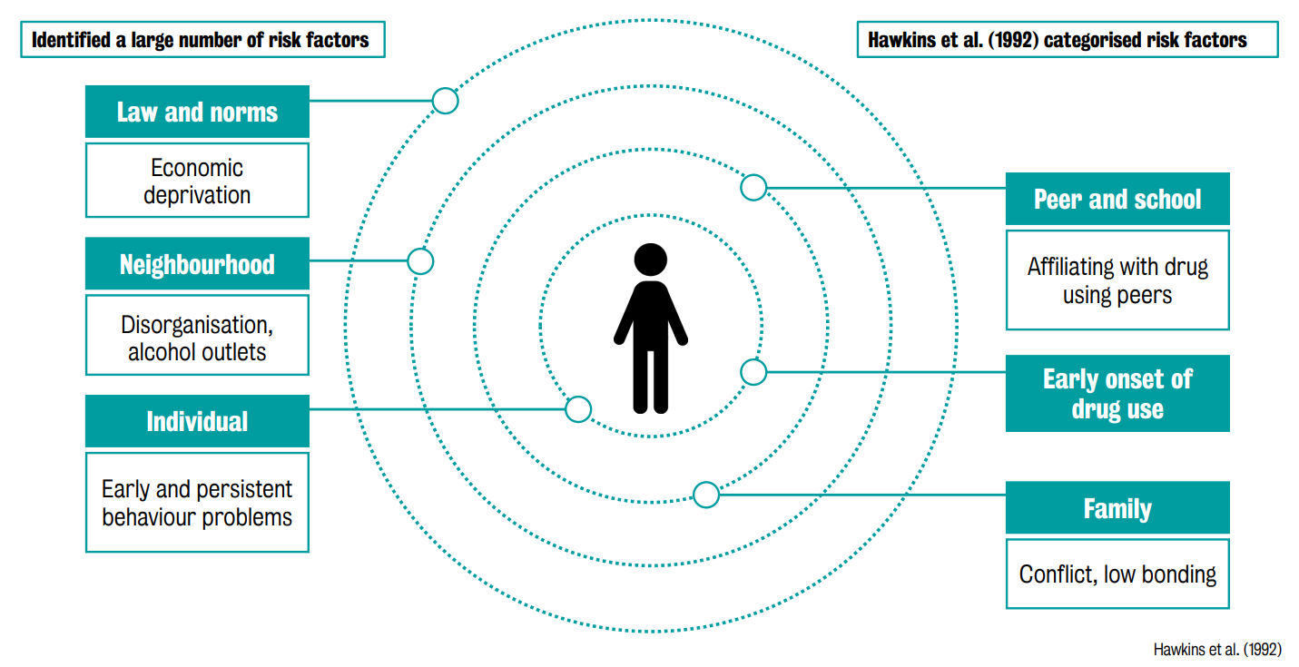

Slide 17
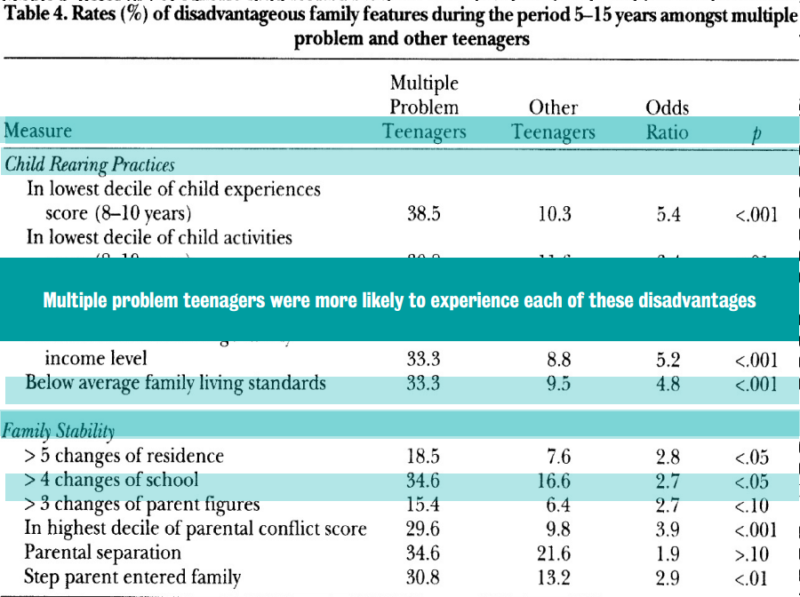

Slide 18
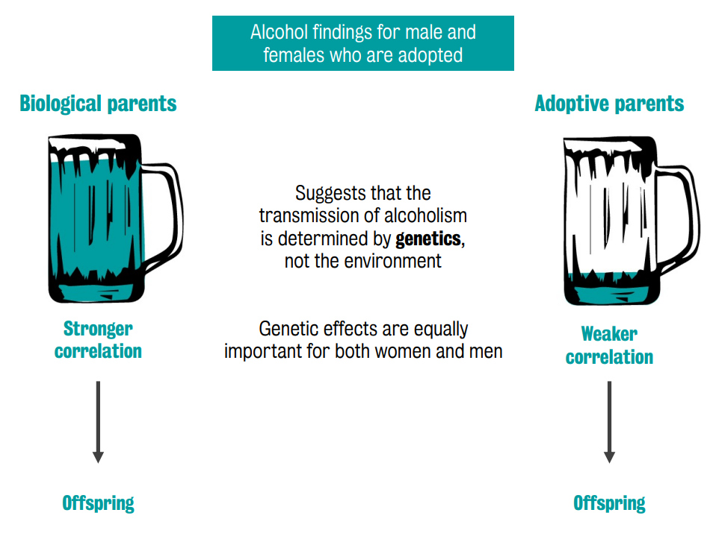

Slide 19
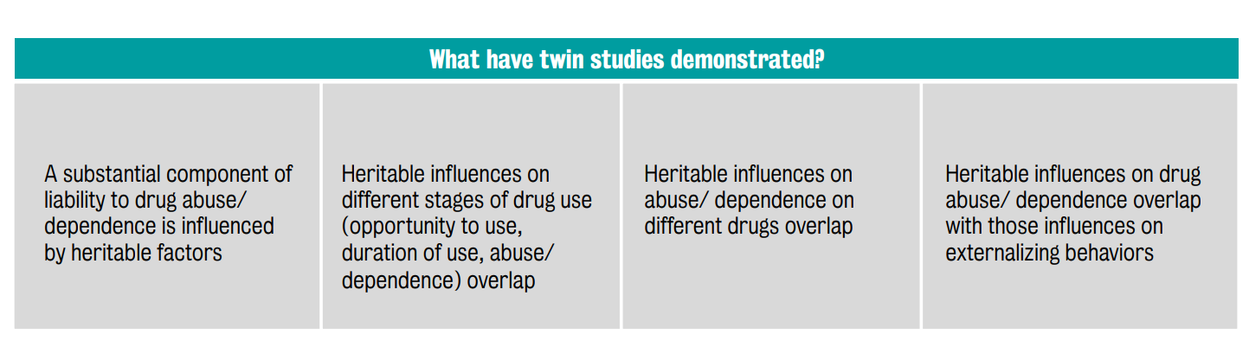

Slide 20
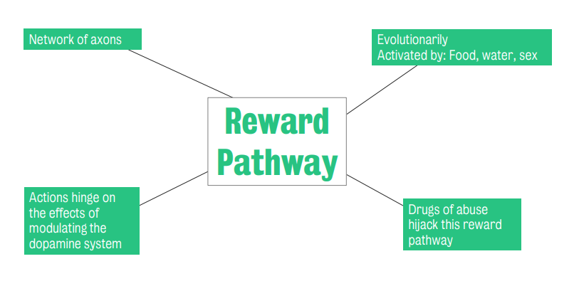
Biology of addiction to drugs

Slide 21
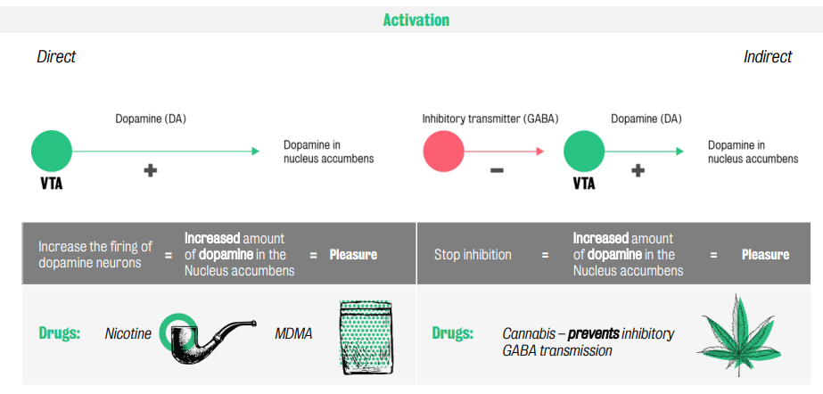

Slide 22
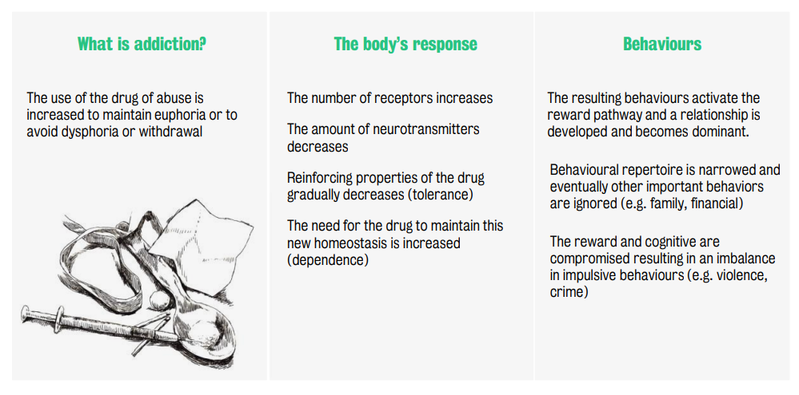

Slide 23
Example of stress
Stress is the subjective state of sensing potentially adverse changes in the environment that will lead to a response that enables the animal to adapt to the changing environment.
Stress is a process with the following steps:
The adverse changes in the environment are perceived by the brain regions, leading to release of stress mediator molecules to deal with the changes
This triggers the stress responses in the person, including physiological, cognitive and behavioral responses, that enable the person to adapt to the stressful changes in the environment

Slide 24
Biology of stress
Associated with activation of the HPA axis (hypothalamic–pituitary–adrenal axis).
This involves the activation of the region of the brain called hypothalamus, which then activates the pituitary glands and then affects the adrenal cortex activating the adrenal glands.
The adrenal gland releases the hormone cortisol in the blood. This causes changes in the sympathetic nervous system, which governs the fight or flight response, causing changes such as pupil dilation, conversion of glycogen to glucose, secretion of adrenaline and noradrenaline, reduces the bladder constriction and digestive system, increases heart rate etc. It also causes changes in the immune system, cardiovascular system affecting blood pressure, and related changes, in such a way that one is better equipped to deal with the stressor.
This normal adaptive response is termed as allostasis.
Repeated, prolonged or chronic stress can reduce the effectiveness of the normal allostatic response of the body It can weaken our immune system, cause health conditions such as diabetes and significantly weaken our standard of life – allostatic load

Slide 25
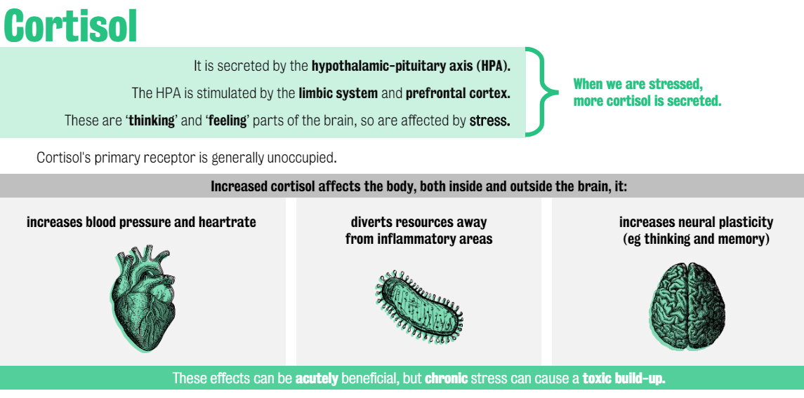
Biology of Stress

Slide 26
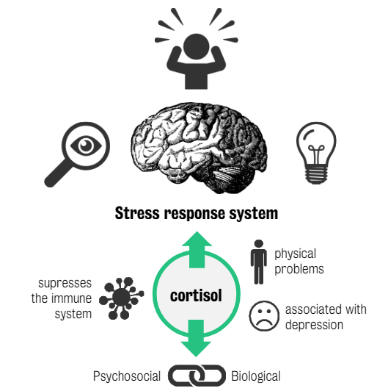
Stress response system

Slide 27
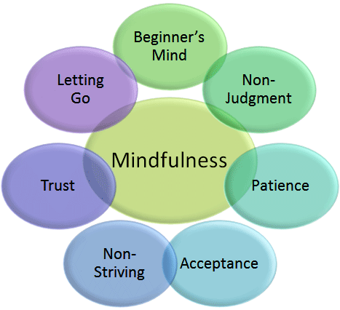
Mindfulness for stress reduction
Mindfulness involves exercises such as sitting in a meditation posture and paying attention to the breath as it comes in an goes out through the nostrils.
One pays gentle and sustained focused attention on the breath. If the mind wanders, such as a thought occurs or an itch or pain sensation occurs, one notices the sensation, and gently returns to noting the breath.
Mechanism: training us to note our body sensations as they occur and thus increase our awareness of the stress response. It also trains us to accept our thoughts and feelings as they occur, without judging them as desirable or not.
8 week Structured program: Mindfulness based Stress Reduction (MBSR)
Mindfulness helps to enhance the immune system and other mechanisms.
Biological markers of stress such as the cortisol levels in saliva and blood, blood pressure, heart rate variability, cytokine levels, and so on have been measured in various studies

Slide 28
Example of Depression
Affects about one in five adults, median onset is about 25 years of age, leading cause of morbidity (DALYs – disability adjusted life year)
One third genetic, two third environmental (social traumas, financial, health problems)
Associated with change in inflammatory markers in immune system
Monoamine hypothesis: depression due to deficiency of neurotransmitter levels in the brain
Antidepressants can help to reduce the symptoms: increased number of new neurons

Slide 29
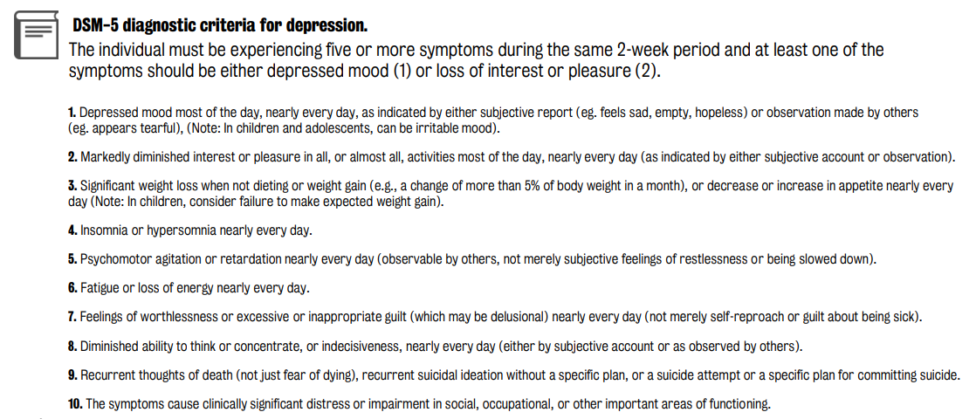
Example of Depression

Slide 30
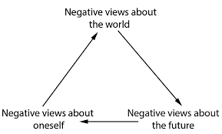
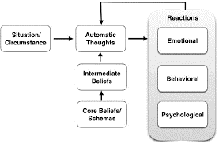
Cognitive Behavioral Therapy
Cognitive model

Slide 31
Cognitive Behavioral Therapy for Depression
Identifying negative thoughts, emotions and behaviors: The client is encouraged to monitor their automatic thoughts, emotions and behaviors that occur every day.
Challenging negative thought patterns: Once the negative thoughts are identified, the client is encouraged to examine each thought and challenge the assumptions underlying such thoughts and emotions, sometimes with evidence of the opposite.
Action plans and activities to strengthen positive behaviors: The client is encouraged to cultivate positive emotions and experiences. This can be done by encouraging them to bring to mind positive memories and positive incidents during the day. This enables them to focus more on the positive incidents rather than only the negative ones.

Slide 32
Using Psychology to Improve Learning
Classical conditioning: Every time you get distracted (conditioned stimulus) in middle of the study session, pinch yourself (conditioned response).
Operant conditioning: Reward yourself e.g. with a chocolate, every time you master each new concept, or part of a chapter.
Listen to pleasant music during learning the topic, to pair the learning with the pleasantness of the music.
Working memory: While studying, pair visual (seeing the graphs or figures) and phonological (reading the notes or book chapters of the topic) concepts. For example, one can read the concept as text, watch a YouTube video about the concept, see some pictures of illustration of how the concept is applied etc.
Using CBT: Noticing what kind of thoughts demotivate us from learning, and then writing them down and analyzing the validity of such thoughts.

